Slide 1
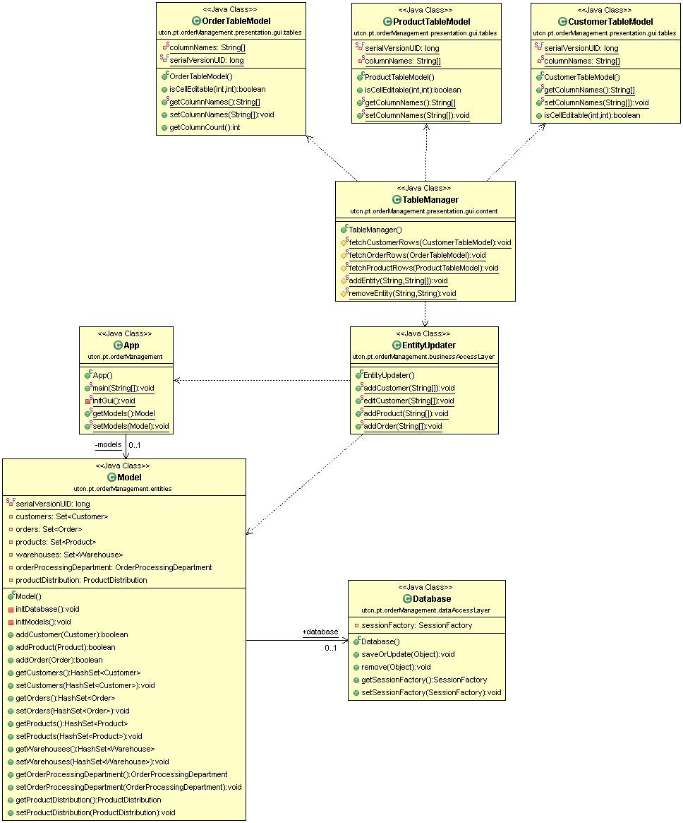
Presentation
Business logic
Data Access
Models

